Slide 1
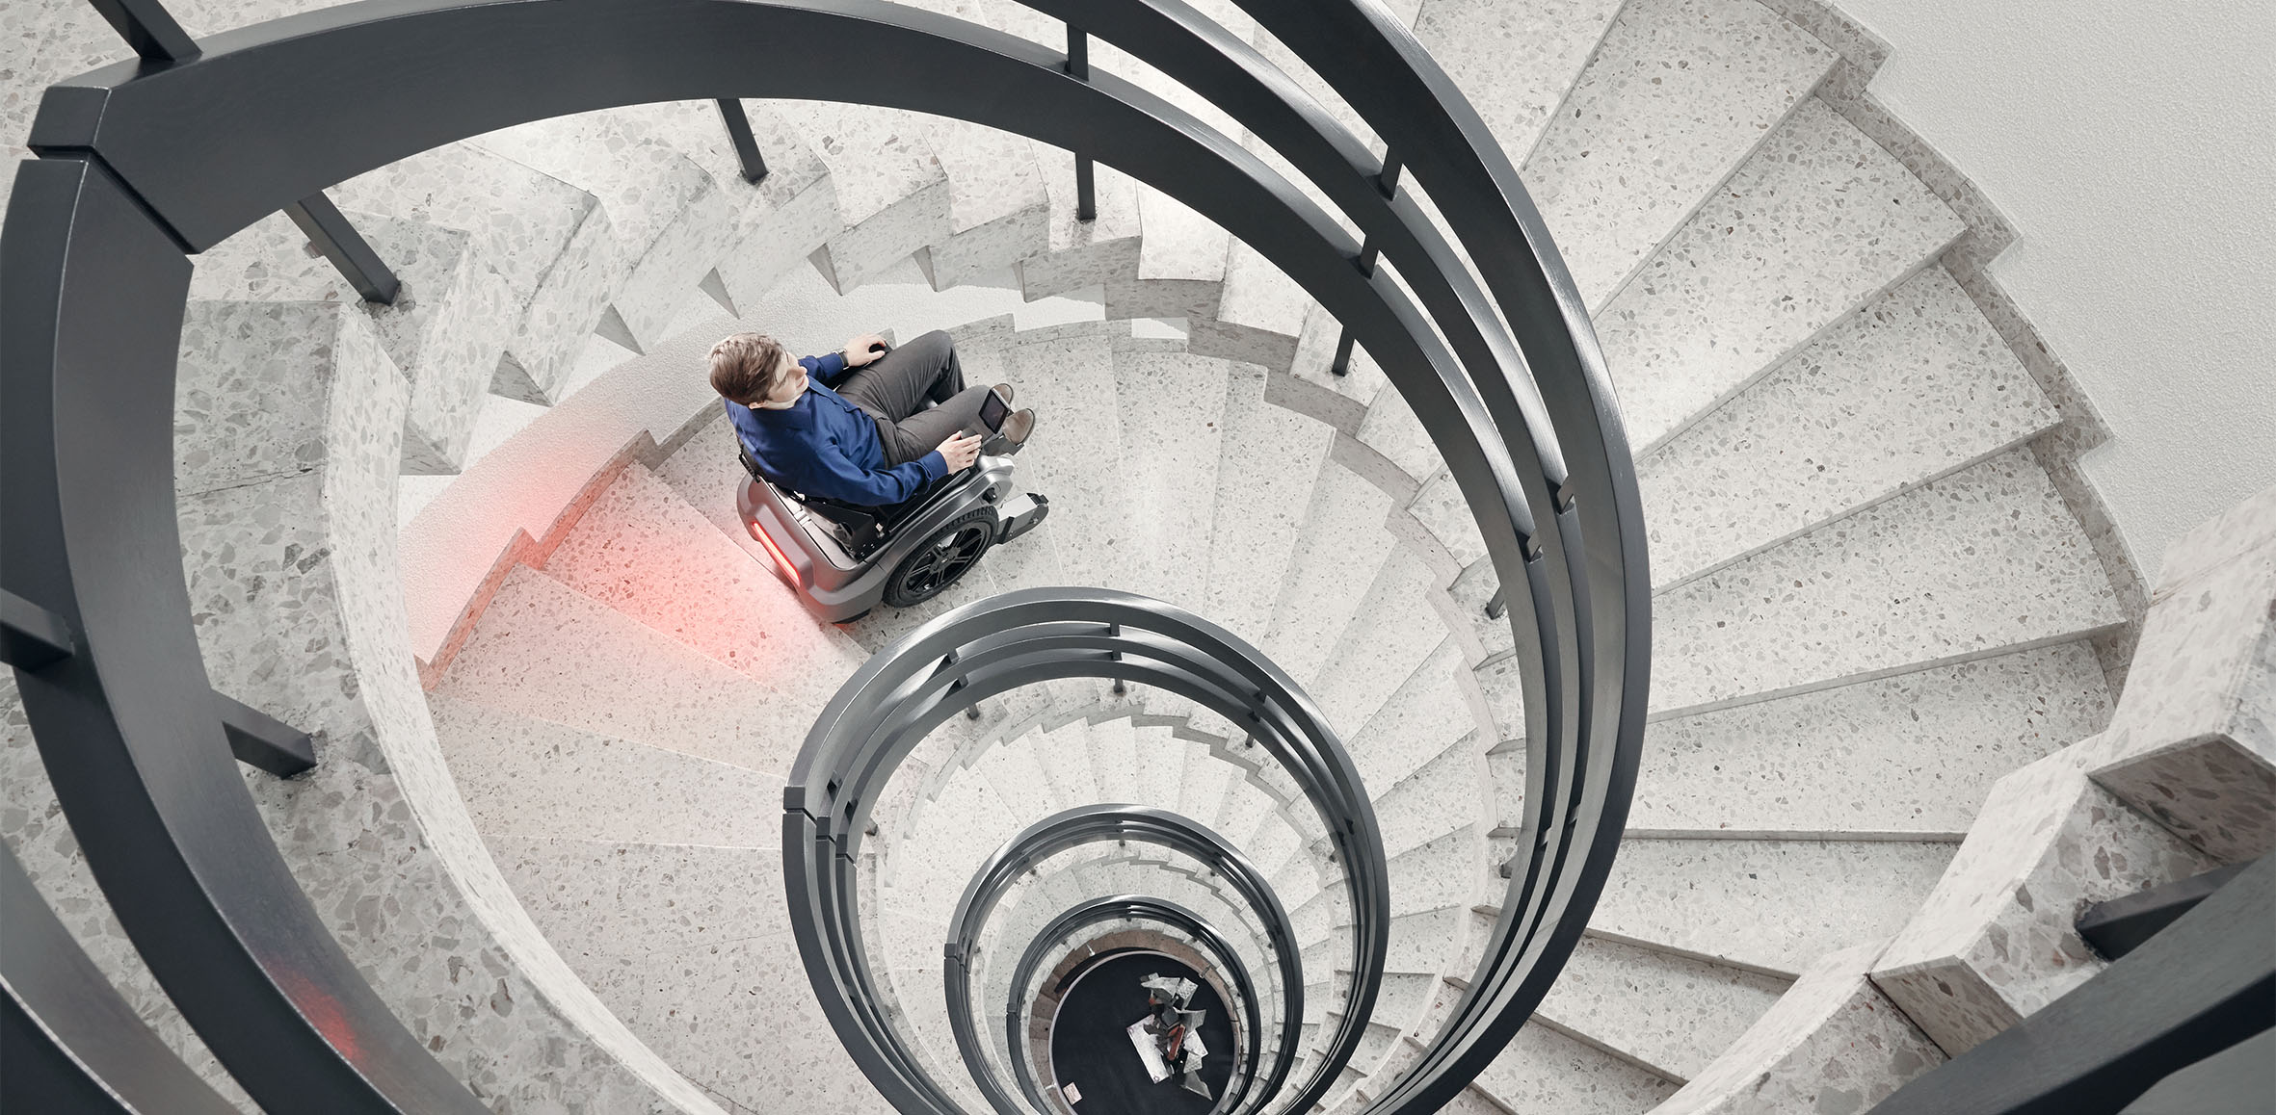
A Mathematical Formulation of Cost-Aware Buffer Placement for Dataflow Circuit Optimization
Yuan Qin
July 16th, 2024

Slide 2
Background
Start: i=0
for (i=0; i<900; i++)
A[i] = A[i] + B[i];
HLS: codes to circuits
Dynamic HLS produces high performance dataflow circuits
Merge
Fork
1
Merge
Load B[i]
+
Data
Ready
Handshake Mechanism
Data
Valid
Ready
Valid
Load A[i]
Fork
900
Fork
+
<
Branch
Store A[i]
This work: A strategy to reduce the cost of HLS-produced dataflow circuits

Slide 3
Background
Start: i=0
Merge
Merge
Fork
1
Load B[i]
+
Require a Choice
Load A[i]
Fork
900
Branch
+
<
Branch
Store A[i]
Optimizing dataflow circuit performance → optimizing loops (CFDFCs)

Slide 4
Background
Start: i=0
Merge
Join
Fork
1
Load B[i]
+
Do not require a Choice
Load A[i]
Fork
900
Fork
+
<
Branch
Store A[i]
Optimizing dataflow circuit performance → optimizing loops (CFDFCs)

Slide 5
Background
Start: i=0
Choice-free Dataflow Circuit
(CFDFC)
for (i=0; i<900; i++)
A[i] = A[i] + B[i];
Merge
Fork
Fork
1
1
900 Times
Load B[i]
+
Load B[i]
+
Load A[i]
Load A[i]
Fork
Fork
900
900
+
<
+
<
Branch
Join
Store A[i]
Store A[i]
Optimizing dataflow circuit performance → optimizing loops (CFDFCs)

Slide 6
Background
Choice-free Dataflow Circuit
(CFDFC)
Fork
1
Load B[i]
+
Load A[i]
Fork
900
+
<
Join
Store A[i]

Slide 7
Why Buffer Placement is Important?
Choice-free Dataflow Circuit
(CFDFC)
Buffers
reg
Fork
Regulate critical paths
Accommodate tokens
Help improve throughput
(Requires a good placement)
1
🤝
Load B[i]
+
Load A[i]
Fork
900
+
<
Next slide: example of suboptimal placement leads to throughput degradation
Join
Store A[i]

Slide 8
Why Buffer Placement is Important?
Assume Initiation Interval (II) = 1
Fork
Fork
*
*
*
BUFF
Stall
+
+
+
Can these circuits take token every II=1 cycle?

Slide 9
Why Buffer Placement is Important?
Assume Initiation Interval (II) = 1
Fork
Fork
*
*
BUFF
Stall
+
+
II = 5
Can these circuits take token every II=1 cycle?

Slide 10
Why Buffer Placement is Important?
Assume Initiation Interval (II) = 1
Fork
Fork
*
*
Stall
+
+
II = 5
Can these circuits take token every II=1 cycle?

Slide 11
Why Buffer Placement is Important?
Assume Initiation Interval (II) = 1
Fork
Fork
*
*
Stall
+
+
II = 5
Can these circuits take token every II=1 cycle?

Slide 12
Why Buffer Placement is Important?
Assume Initiation Interval (II) = 1
Fork
Fork
*
*
Stall
+
+
II = 5
Can these circuits take token every II=1 cycle?

Slide 13
Why Buffer Placement is Important?
Assume Initiation Interval (II) = 1
Fork
Fork
*
*
Stall
+
+
II = 5
Can these circuits take token every II=1 cycle?

Slide 14
Why Buffer Placement is Important?
Assume Initiation Interval (II) = 1
Fork
Fork
*
*
Stall
+
+
II = 5
Can these circuits take token every II=1 cycle?

Slide 15
Why Buffer Placement is Important?
Assume Initiation Interval (II) = 1
Fork
Fork
*
*
Stall
+
+
II = 5
Can these circuits take token every II=1 cycle?

Slide 16
Why Buffer Placement is Important?
Assume Initiation Interval (II) = 1
Fork
Fork
*
*
Stall
+
+
II = 5
Can these circuits take token every II=1 cycle?

Slide 17
Why Buffer Placement is Important?
Assume Initiation Interval (II) = 1
Fork
Fork
*
*
Stall
+
+
II = 5
II = 1
Can these circuits take token every II=1 cycle?

Slide 18
Why Buffer Placement is Important?
Assume Initiation Interval = 1
Fork
(Sender)
Fork
Fork
*
*
BUFF
Stall
+
+
*
(Receiver)
Can these circuits take token every II=1 cycle?
Notes:
Let’s imagine a token is valid on the sender side,……….(替代only one token）

Slide 19
Why Buffer Placement is Important?
Assume Initiation Interval = 1
Fork
(Sender)
Fork
Fork
*
*
BUFF
Stall
BUFF
+
+
*
(Receiver)
Can these circuits take token every II=1 cycle?

Slide 20
We Have Achieved the Best Throughput, But Can We Do Better?
Fork
Fork
Transparent FIFO
Slot # = 5
*
*
BUFF
LUT # = 81
Register # = 168
(Under bitwidth 32)
Stall
+
+
Buffers occupy the majority of the circuit area: we should place them strategically
Notes:
The transparent fifo is very expensive but it is not the only buffer to achieve the best throughput

Slide 21
Can We Use Cheaper Buffers While Maintaining the Throughput?
A wider range of buffer types
Fork
Tail
*
BUFF
Head
+
Transparent FIFO
OEHB Chain
Pipeline
LUT # = 81
Register # = 168
LUT # = 10
Register # = 165
LUT # = 1
Register # = 165
Buffers occupy the majority of the circuit area: we should place them strategically
Notes:
标上head and tail

Slide 22
Motivation
A wider range of buffer types
Fork
Tail
*
FIFO
Head
+
Transparent FIFO
OEHB Chain
Pipeline
LUT # = 81
Register # = 168
LUT # = 10
Register # = 165
LUT # = 1
Register # = 165
Buffers occupy the majority of the circuit area: we should place them strategically

Slide 23
Motivation
A wider range of buffer types
Fork
Tail
*
FIFO
Head
+
Transparent FIFO
OEHB Chain
Pipeline
LUT # = 81
Register # = 168
LUT # = 10
Register # = 165
LUT # = 1
Register # = 165
Buffers occupy the majority of the circuit area: we should place them strategically

Slide 24
Motivation
A wider range of buffer types
Fork
Tail
*
FIFO
Head
+
Transparent FIFO
OEHB Chain
Pipeline
LUT # = 81
Register # = 168
LUT # = 10
Register # = 165
LUT # = 1
Register # = 165
Buffers occupy the majority of the circuit area: we should place them strategically

Slide 25
Motivation
A wider range of buffer types
Fork
Tail
*
FIFO
Head
+
Transparent FIFO
OEHB Chain
Pipeline
LUT # = 81
Register # = 168
LUT # = 10
Register # = 165
LUT # = 1
Register # = 165
Buffers occupy the majority of the circuit area: we should place them strategically

Slide 26
Motivation
A wider range of buffer types
Fork
Tail
*
FIFO
Head
+
Transparent FIFO
OEHB Chain
Pipeline
LUT # = 81
Register # = 168
LUT # = 10
Register # = 165
LUT # = 1
Register # = 165
Buffers occupy the majority of the circuit area: we should place them strategically

Slide 27
Motivation
A wider range of buffer types
Fork
Tail
*
FIFO
Head
+
Transparent FIFO
OEHB Chain
Pipeline
LUT # = 81
Register # = 168
LUT # = 10
Register # = 165
LUT # = 1
Register # = 165
Buffers occupy the majority of the circuit area: we should place them strategically
Notes:
记得提及all valid

Slide 28
Motivation
A wider range of buffer types
Fork
Tail
*
FIFO
Head
+
Transparent FIFO
OEHB Chain
Pipeline
LUT # = 81
Register # = 168
LUT # = 10
Register # = 165
LUT # = 1
Register # = 165
Same performance, but very different costs!

Slide 29
Motivation
A wider range of buffer types
Fork
Tail
*
FIFO
Head
+
Transparent FIFO
OEHB Chain
Pipeline
LUT # = 81
Register # = 168
LUT # = 10
Register # = 165
LUT # = 1
Register # = 165
Our work: Automatically selects the cheapest solution while maintaining the performance

Slide 30
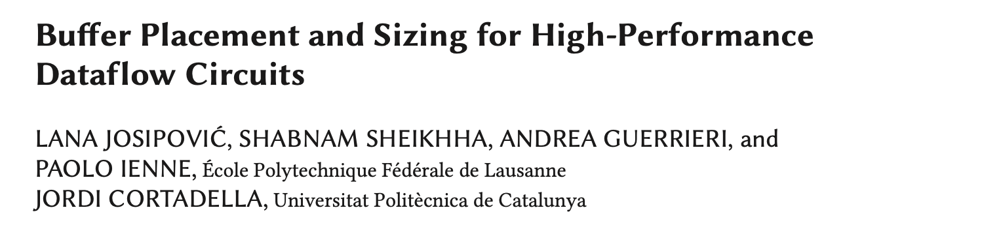
Prior Works Cannot Achieve This
Limitations of the prior works:
Ignoring the cost differences between buffer types
Only two buffer types

Slide 31
Our Contribution: A New Buffer Placement Strategy
Objectives: Minimizing area cost, maximizing throughput.
How? A general cost + performance model for buffers.
What are the attributes of these buffers?
Notes:
Model--》attribute glue text

Slide 32
We Model the Buffers in This Way
OEHB Chain
TEHB Chain
Full-transparent FIFO
Pipeline
……
Minimum latency
Maximum latency
Slot number
Decompose N-slot to 1-slot
N-slots
In the following: We study the single-slot properties of these buffer types
Notes:
提一下标题;
We will see what these attributes mean specifically in the following examples

Slide 33
We Model the Buffers in This Way
OEHB Chain
TEHB Chain
Full-transparent FIFO
Pipeline
Minimum latency means the minumum clock cycles a token resides in this buffer during the whole process it passes through the buffer.
Maximum latency means the maximum clock cycles a token resides in this buffer which will not violate the initiation interval of the circuit.
Cycle 0
Min. latency =
Max. latency =
Notes:
把定义打在上面并留到整个过程

Slide 34
We Model the Buffers in This Way
OEHB Chain
TEHB Chain
Full-transparent FIFO
Pipeline
Minimum latency means the minumum clock cycles a token resides in this buffer during the whole process it passes through the buffer.
Maximum latency means the maximum clock cycles a token resides in this buffer which will not violate the initiation interval of the circuit.
Cycle 0
1
Min. latency =
Max. latency =
Cycle 1

Slide 35
We Model the Buffers in This Way
OEHB Chain
TEHB Chain
Full-transparent FIFO
Pipeline
Minimum latency means the minumum clock cycles a token resides in this buffer during the whole process it passes through the buffer.
Maximum latency means the maximum clock cycles a token resides in this buffer which will not violate the initiation interval of the circuit.
Cycle 0
1
Min. latency =
Max. latency =
Buffer incapable of storing a certain max. latency → system stall

Slide 36
We Model the Buffers in This Way
OEHB Chain
TEHB Chain
Full-transparent FIFO
Pipeline
Minimum latency means the minumum clock cycles a token resides in this buffer during the whole process it passes through the buffer.
Maximum latency means the maximum clock cycles a token resides in this buffer which will not violate the initiation interval of the circuit.
Cycle II
1
Min. latency =
Max. latency =
Buffer incapable of storing a certain max. latency → system stall

Slide 37
We Model the Buffers in This Way
OEHB Chain
TEHB Chain
Full-transparent FIFO
Pipeline
Minimum latency means the minumum clock cycles a token resides in this buffer during the whole process it passes through the buffer.
Maximum latency means the maximum clock cycles a token resides in this buffer which will not violate the initiation interval of the circuit.
Cycle II
1
Min. latency =
Max. latency =
II
Cycle II
Buffer incapable of storing a certain max. latency → system stall

Slide 38
We Model the Buffers in This Way
OEHB Chain
TEHB Chain
Full-transparent FIFO
Pipeline
Minimum latency means the minumum clock cycles a token resides in this buffer during the whole process it passes through the buffer.
Maximum latency means the maximum clock cycles a token resides in this buffer which will not violate the initiation interval of the circuit.
Min. latency = N
N-slots
Max. latency = N * II

Slide 39
We Model the Buffers in This Way
OEHB Chain
TEHB Chain
Full-transparent FIFO
Pipeline
Minimum latency means the minumum clock cycles a token resides in this buffer during the whole process it passes through the buffer.
Maximum latency means the maximum clock cycles a token resides in this buffer which will not violate the initiation interval of the circuit.
Min. latency =
0
Cycle 0
Max. latency =
Notes:
在slot上面加bypass
把network去掉

Slide 40
We Model the Buffers in This Way
OEHB Chain
TEHB Chain
Full-transparent FIFO
Pipeline
Minimum latency means the minumum clock cycles a token resides in this buffer during the whole process it passes through the buffer.
Maximum latency means the maximum clock cycles a token resides in this buffer which will not violate the initiation interval of the circuit.
Cycle II
0
Min. latency =
Max. latency =
II - 1
Cycle II-1
Buffer incapable of storing a certain max. latency → system stall

Slide 41
We Model the Buffers in This Way
OEHB Chain
TEHB Chain
Full-transparent FIFO
Pipeline
Minimum latency means the minumum clock cycles a token resides in this buffer during the whole process it passes through the buffer.
Maximum latency means the maximum clock cycles a token resides in this buffer which will not violate the initiation interval of the circuit.
Min. latency = 0
N-slots
Max. latency = N * (II – 1)

Slide 42
We Model the Buffers in This Way
OEHB Chain
TEHB Chain
Full-transparent FIFO
Pipeline
Minimum latency means the minumum clock cycles a token resides in this buffer during the whole process it passes through the buffer.
Maximum latency means the maximum clock cycles a token resides in this buffer which will not violate the initiation interval of the circuit.
Min. latency = 0
N-slots
Max. latency = N * II

Slide 43
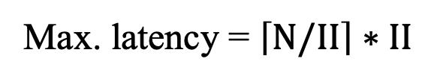
We Model the Buffers in This Way
OEHB Chain
TEHB Chain
Full-transparent FIFO
Pipeline
Minimum latency means the minumum clock cycles a token resides in this buffer during the whole process it passes through the buffer.
Maximum latency means the maximum clock cycles a token resides in this buffer which will not violate the initiation interval of the circuit.
Min. latency =
Min. latency = N
N-slots
Max. latency =
Max. latency = $\left\lceil N/II\right\rceil ∗II$
🤝
Not ready!

Slide 44





We Model the Buffers in This Way
In summary, the relationship between
buffer type, slot number, latency, and circuit II
$$L_{min⁡(type)}≤L≤L_{max⁡(type)}$$
OEHB Chain
TEHB Chain
Full-transparent FIFO
Pipeline
$$N≤L≤N∗II$$
$$0≤L≤N∗(II−1)$$
$$0≤L≤N∗II$$
$$N≤L≤\left\lceil N/II\right\rceil ∗II$$
In the next, we should integrate our model into prior works
Notes:
后面说，in the next we should Integrate our model into prior works

Slide 45




Integrate Our Buffer Model into the Prior Works
Prior Works: the relationship between
buffer type, slot number, token occupancy, and circuit throughput
Latency → Token occupancy
Little’s law:
1/3
$$N= λ ∗T$$
2/3
1/3
1/3
$$\dot{Θ}=Θ∗L$$
$$\dot{Θ}=L/II$$
$$Θ=1/II$$
Notes:
buffer type, slot number, token occupancy, and circuit II

Slide 46










Integrate Our Buffer Model into the Prior Works
OEHB Chain
TEHB Chain
Full-transparent FIFO
Pipeline
$$N≤L≤N∗II$$
$$0≤L≤N∗(II−1)$$
$$\dot{Θ}=L/II$$
$$0≤L≤N∗II$$
$$Θ=1/II$$
$$N≤L≤\left\lceil N/II\right\rceil ∗II$$
OEHB Chain
TEHB Chain
Full-transparent FIFO
Pipeline
$$N∗Θ≤\dot{Θ}≤N$$
$$0≤\dot{Θ}≤N∗(1−Θ)$$
$$0≤\dot{Θ}≤N$$
$$N∗Θ≤\dot{Θ}≤\left\lceil N∗Θ\right\rceil$$

Slide 47

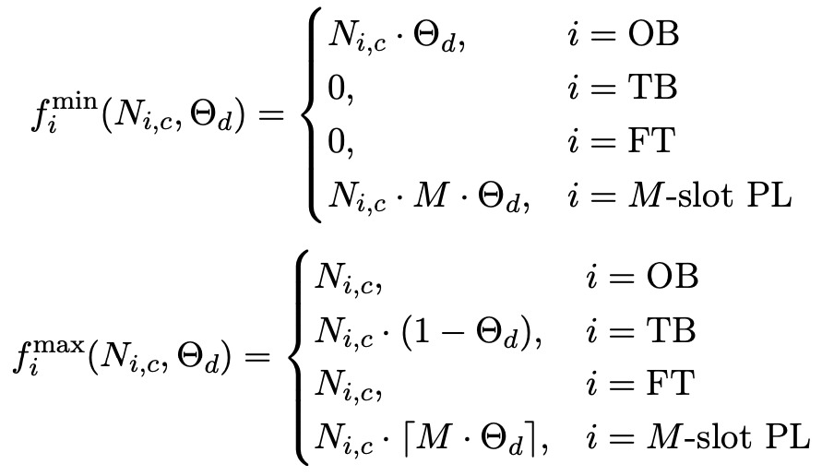
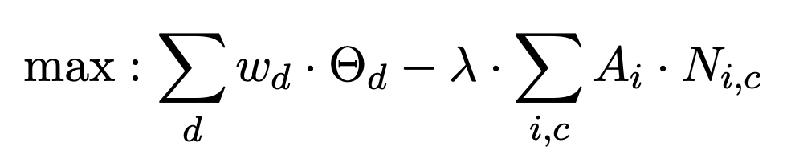
Optimization Model
Timing Constraints
Throughput Constraints
Objective
$$N_{OB}∗Θ+N_{PL}∗Θ≤\dot{Θ}≤N_{OB}+N_{TB}∗\left(1−Θ\right)+N_{FT}+\left\lceil N_{PL}∗Θ\right\rceil$$
Mixed Integer Quadratically Constrained Programming (MIQCP)
Notes:
把constraints放进一页

Slide 48
Optimization Model
Objective:
Weighted sum of all CFDFCs’ throughput $−$ the total buffer area
Buffer area is a function of slot number
Gain coefficients by synthesis (LUT #)
OEHB Chain
2
TEHB Chain
25
Not linear in fact!
Full-tran. FIFO
19
Pipeline
<1
Notes:
文本的方式去写，we maximize throughput minimize buffer cost

Slide 49
Experimental Results
We experimented on 9 benchmarks where we perform buffer placement strategy of dynamitic, our work and FPGA ’20 (using gurobi). The target clock period is 6ns.
We run Modelsim to calculate total clock cycles (representing throughput) and run Vivado synthesis to calculate area cost.
We mainly compare LUT costs, and make sure our work achieves the best throughput. Register costs and timing slack should be within a reasonable range.

Slide 50
Experimental Results
Benchmark | Cycle # |  |  | Slack
 | Dynamatic | Our Work | FPGA20 | Dynamatic | Our Work | FPGA20
fir | 1014 | 1014 | 1014 | 2.084 | 1.324 | 1.313
iir | 5007 | 4008 | 4008 | 1.066 | 2.267 | 1.964
if_loop_1 | 213 | 113 | 112 | 0.617 | 0.462 | 0.518
if_loop_2 | 211 | 111 | 111 | 0.619 | 0.521 | 0.451
sumi3_mem | 1019 | 1018 | 1018 | 2.041 | 2.268 | 2.278
vedio_filter | 1368 | 949 | 948 | 0.856 | 0.957 | 0.893
matvec | 10119 | 10119 | 10118 | 1.551 | 0.272 | 0.471
image_resize | 1065 | 945 | 944 | 1.789 | 1.997 | 0.99
matrix | 40548 | 27948 | 27948 | 1.187 | 0.975 | 0.779
Notes:
目标放到slides上，下面放结论
Fpga20改进了dynamatic的implementation，把不对的东西纠正了，为了对比也放在上面。
单独一页详细说比较的东西。

Slide 51
Experimental Results
Benchmark | Utilization |  |  |  |  |  |  |  |  | Savings (%) Compared with
 | Dynamatic |  |  | Our work |  |  | FPGA '20 |  |  | FPGA '20 |  | Dynamatic
 | LUT |  | Register | LUT |  | Register | LUT |  | Register | LUT | Reg. | LUT | Reg.
 | Total | Logic |  | Total | Logic |  | Total | Logic
fir | 466 | 470 | 531 | 436 | 434 | 528 | 461 | 457 | 535 | 5.4 | 1.3 | 6.44 | 0.56
iir | 666 | 666 | 869 | 700 | 689 | 844 | 826 | 810 | 848 | 15.3 | 0.5 | -5.11 | 2.88
if_loop_1 | 521 | 521 | 630 | 594 | 592 | 668 | 664 | 660 | 736 | 10.5 | 9.2 | -14.01 | -6.03
if_loop_2 | 543 | 543 | 596 | 602 | 602 | 629 | 625 | 625 | 666 | 3.7 | 5.6 | -10.87 | -5.54
sumi3_mem | 437 | 409 | 426 | 373 | 339 | 469 | 435 | 407 | 457 | 14.3 | -2.6 | 14.65 | -10.09
vedio_filter | 1547 | 1459 | 1187 | 1326 | 1247 | 1322 | 1593 | 1485 | 1400 | 16.8 | 5.6 | 14.29 | -11.37
matvec | 699 | 641 | 579 | 575 | 533 | 597 | 673 | 653 | 604 | 14.6 | 1.2 | 17.74 | -3.11
image_resize | 612 | 564 | 531 | 595 | 551 | 562 | 646 | 606 | 630 | 7.9 | 10.8 | 2.78 | -5.84
matrix | 841 | 777 | 587 | 656 | 642 | 599 | 774 | 754 | 639 | 15.2 | 6.3 | 22.00 | -2.04

Slide 52
Experimental Results
Benchmark | Total Slot # |  |  |  |  |  |  |  | LUT Reduction
 | Our Work |  |  |  | FPGA '20
 | OEHB | TEHB | FIFO | Pipeline | OEHB | TEHB | FIFO | Pipeline
fir | 3 | 3 | 0 | 9 | 3 | 3 | 9 | 0 | 25
iir | 5 | 5 | 0 | 5 | 6 | 6 | 2 | 0 | 126
if_loop_1 | 6 | 4 | 0 | 6 | 7 | 7 | 4 | 0 | 70
if_loop_2 | 7 | 4 | 0 | 0 | 7 | 7 | 0 | 0 | 23
sumi3_mem | 3 | 3 | 0 | 20 | 3 | 3 | 20 | 0 | 62
vedio_filter | 9 | 5 | 0 | 53 | 10 | 10 | 49 | 0 | 267
matvec | 8 | 4 | 0 | 26 | 9 | 9 | 19 | 0 | 98
image_resize | 8 | 4 | 0 | 13 | 9 | 9 | 10 | 0 | 51
matrix | 13 | 5 | 0 | 26 | 13 | 13 | 23 | 0 | 118

Slide 53
An Interesting Finding
In fir
TEHB
OEHB
OEHB
TEHB
LUT #: 494
LUT #: 436

Slide 54
Limitations and Future Work
Lazy fork vs. eager fork
Synthesize buffer alone vs. whole circuit
Not linear area utilization
Long runtime
Variable units

Slide 55
Q&A

Slide 56
Motivation
If the channel is on another CFDFC where:
Fork
Lat.=3
*
FIFO
*
Transparent FIFO
OEHB Chain
Pipeline
LUT # = 81
Register # = 168
LUT # = 10
Register # = 165
LUT # = 1
Register # = 165

Slide 57
Motivation
If the channel is on another CFDFC where:
Fork
Stall
Back pressure!
*
FIFO
Throughput ↓
Valid
*
Stall
Valid
Not Valid!
Not Valid!
Transparent FIFO
OEHB Chain
Pipeline
Slot # = 5
Slot # = 5
Slot # = 5

Slide 58
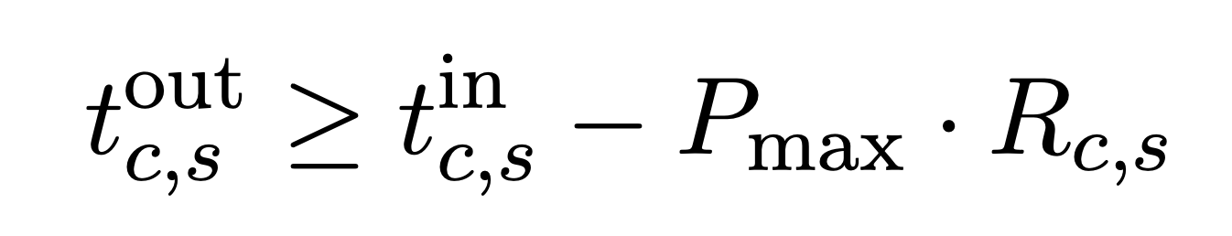
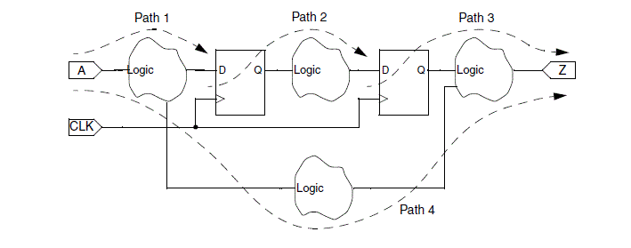
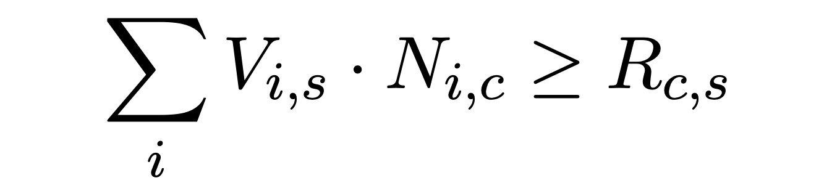
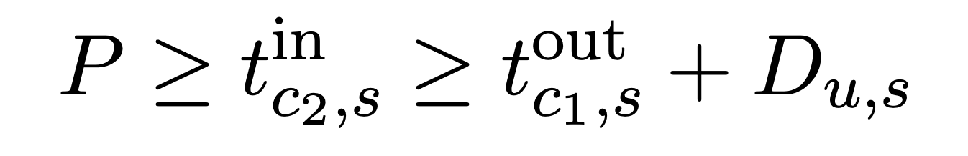


Optimization Model
Timing constraints for the whole circuit.
$$D_{u}$$
$$≤CP$$

Slide 59
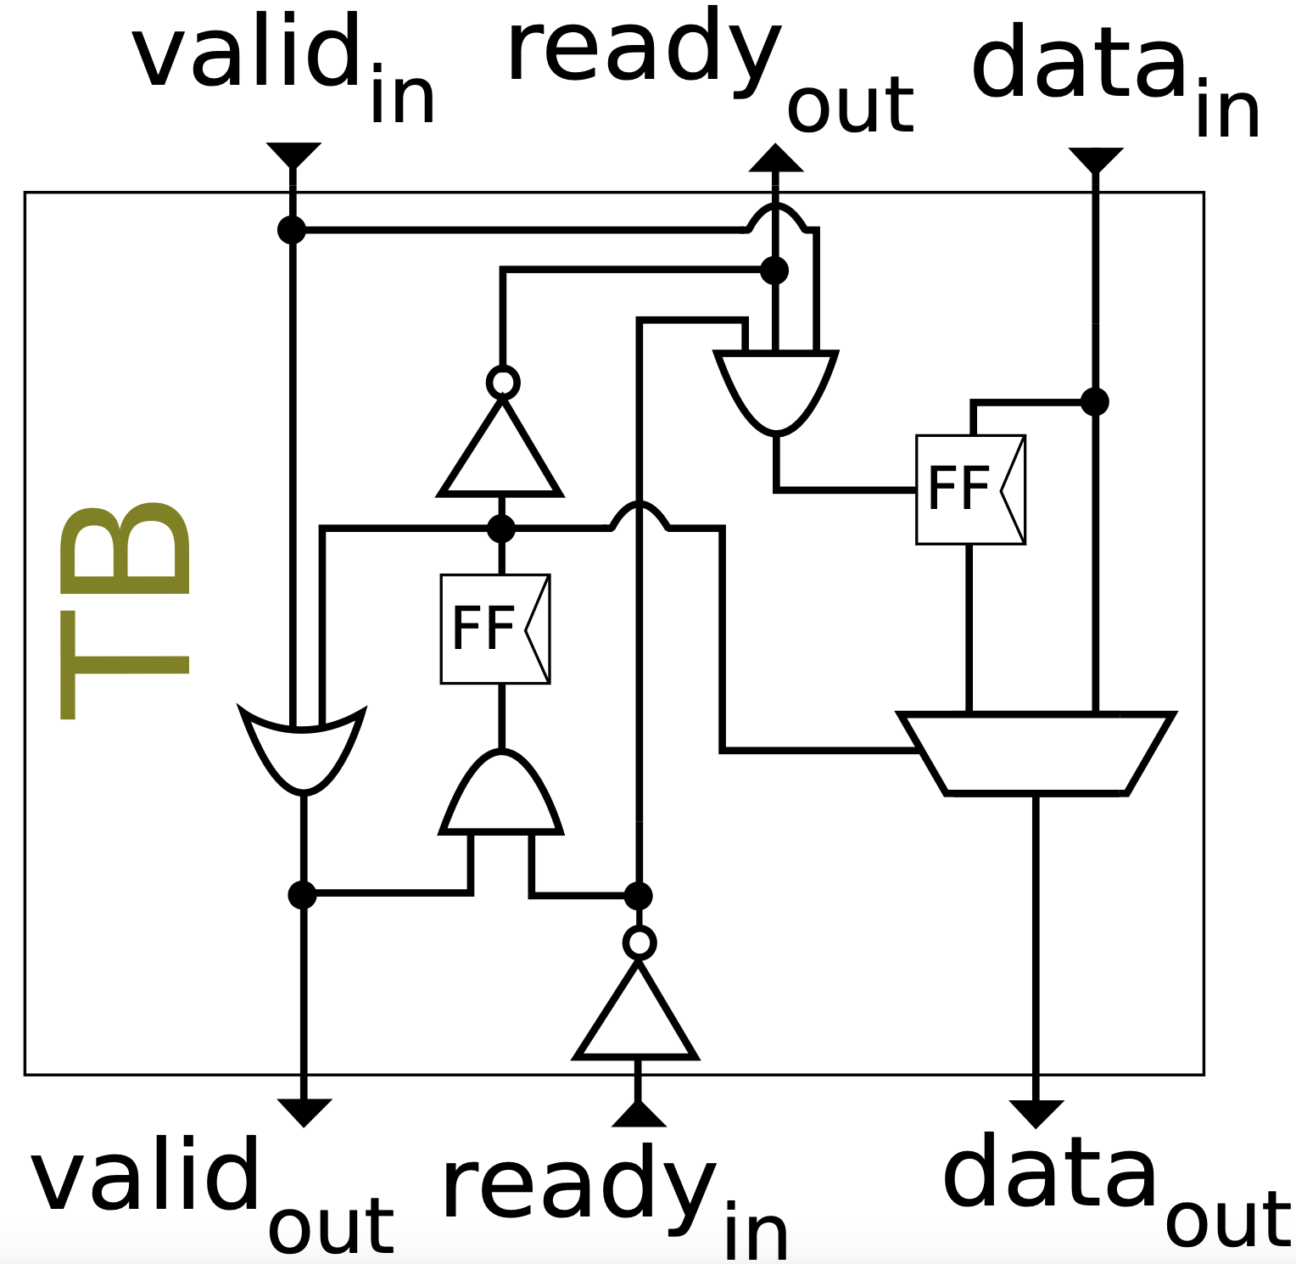
Attributes of Buffers
OEHB Chain
TEHB Chain
Full-transparent FIFO
Pipeline
Min./Max latency under a specific II of CFDFC
#1~II
#0
#II+1
Fork
0
#II+1~2*II
x
0
#1~II
*
#1~II
1
#II+1
#>2*II
#II+1~2*II
*
Min. latency = 0
Max. latency = II-1

Slide 60
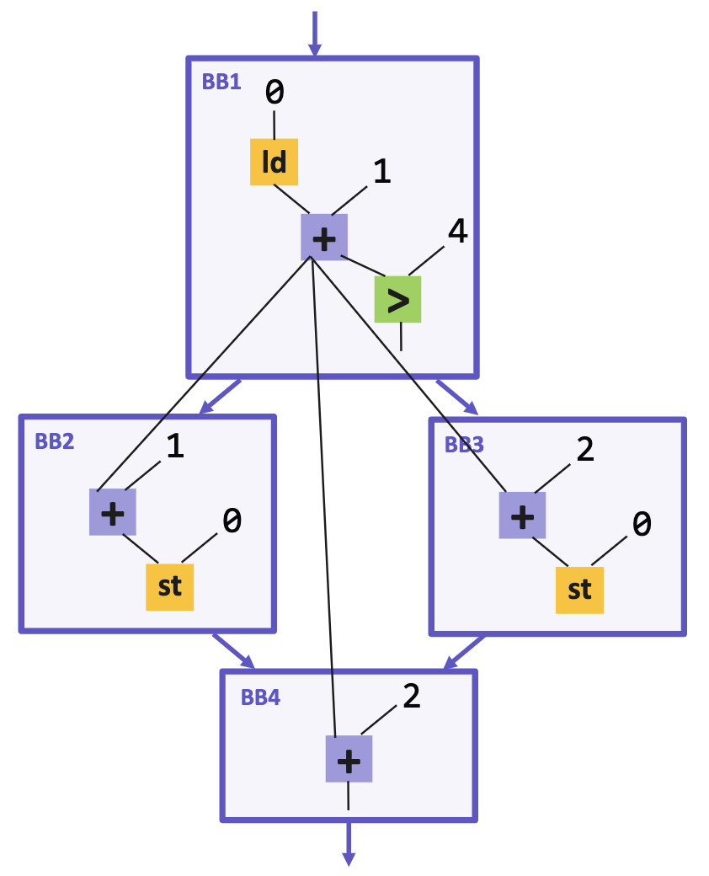

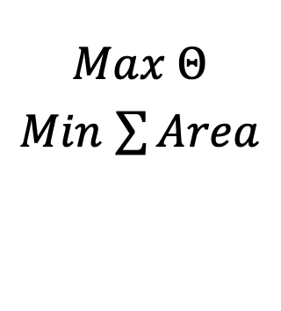
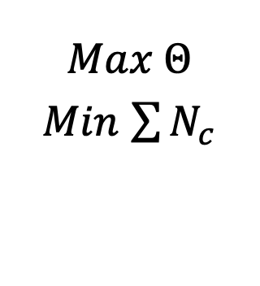

Integrate Our Buffer Model into the Prior Works
CDFG
FPGA ’20
$$∀ Channel c,$$
$$R_{c}, N_{c}$$
$$Max Θ$$
$Min$ $\sum{N_{c}}$
Buffers
$$∀c,R_{c,s},N_{OB},$$
$$N_{TB}, N_{FT}, N_{PL}$$
$$Max Θ$$
$Min$ $\sum{Area}$
Our model
Notes:
介绍一下prior是干什么的，解出来每个channel上的token occupancy；列出模型constraints强调只要小改动就能让他工作，包括objective也放在一起，一页。

Slide 61
Integrate Our Buffer Model into the Prior Works
$$∀ Channel c,$$
$$R_{c}, N_{c}$$
$$Max Θ$$
$Min$ $\sum{N_{c}}$
D
$$∀c,R_{c,s},N_{OB},$$
$$N_{TB}, N_{FT}, N_{PL}$$
$$Max Θ$$
$Min$ $\sum{Area}$
V
R
Notes:
介绍一下prior是干什么的，解出来每个channel上的token occupancy；列出模型constraints强调只要小改动就能让他工作，包括objective也放在一起，一页。

Slide 62


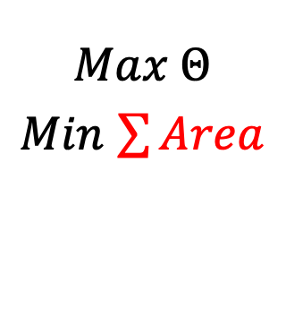
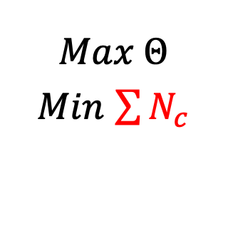

Integrate Our Buffer Model into the Prior Works
FPGA ’20
$$∀ Channel c,$$
$$R_{c}, N_{c}$$
$$Max Θ$$
$Min$ $\sum{N_{c}}$
CDFG
Buffers
$$∀c,R_{c,s},N_{OB},$$
$$N_{TB}, N_{FT}, N_{PL}$$
$$Max Θ$$
$Min$ $\sum{Area}$
Our model
$$\sum{A\left(N_{OB}\right)+A\left(N_{TB}\right)+A\left(N_{FT}\right)+A{(N}_{PL})}$$
Notes:
介绍一下prior是干什么的，解出来每个channel上的token occupancy；列出模型constraints强调只要小改动就能让他工作，包括objective也放在一起，一页。

Slide 63
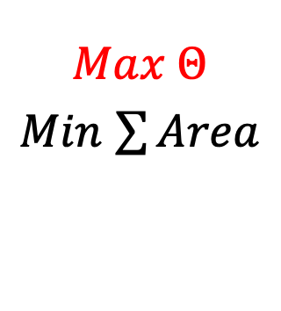

Integrate Our Buffer Model into the Prior Works
FPGA ’20
$$∀ Channel c,$$
$$R_{c}, N_{c}$$
$$Max Θ$$
$Min$ $\sum{N_{c}}$
CDFG
Buffers
$$∀c,R_{c,s},N_{OB},$$
$$N_{TB}, N_{FT}, N_{PL}$$
$$Max Θ$$
$Min$ $\sum{Area}$
Our model
Channels’ token occupancies decide throughput
Notes:
介绍一下prior是干什么的，解出来每个channel上的token occupancy；列出模型constraints强调只要小改动就能让他工作，包括objective也放在一起，一页。

Slide 64




Optimization Model
Throughput constraints for each CFDFC.
OEHB Chain
TEHB Chain
Full-transparent FIFO
Pipeline
$$N∗Θ≤\dot{Θ}≤N$$
$$0≤\dot{Θ}≤N∗(1−Θ)$$
$$0≤\dot{Θ}≤N$$
$$N∗Θ≤\dot{Θ}≤\left\lceil N∗Θ\right\rceil$$
Each channel can have mixed types of buffer.
$$N_{OB}∗Θ+N_{PL}∗Θ≤\dot{Θ}≤N_{OB}+N_{TB}∗\left(1−Θ\right)+N_{FT}+\left\lceil N_{PL}∗Θ\right\rceil$$
Mixed Integer Quadratically Constrained Programming (MIQCP)
Notes:
把constraints放进一页

Slide 65
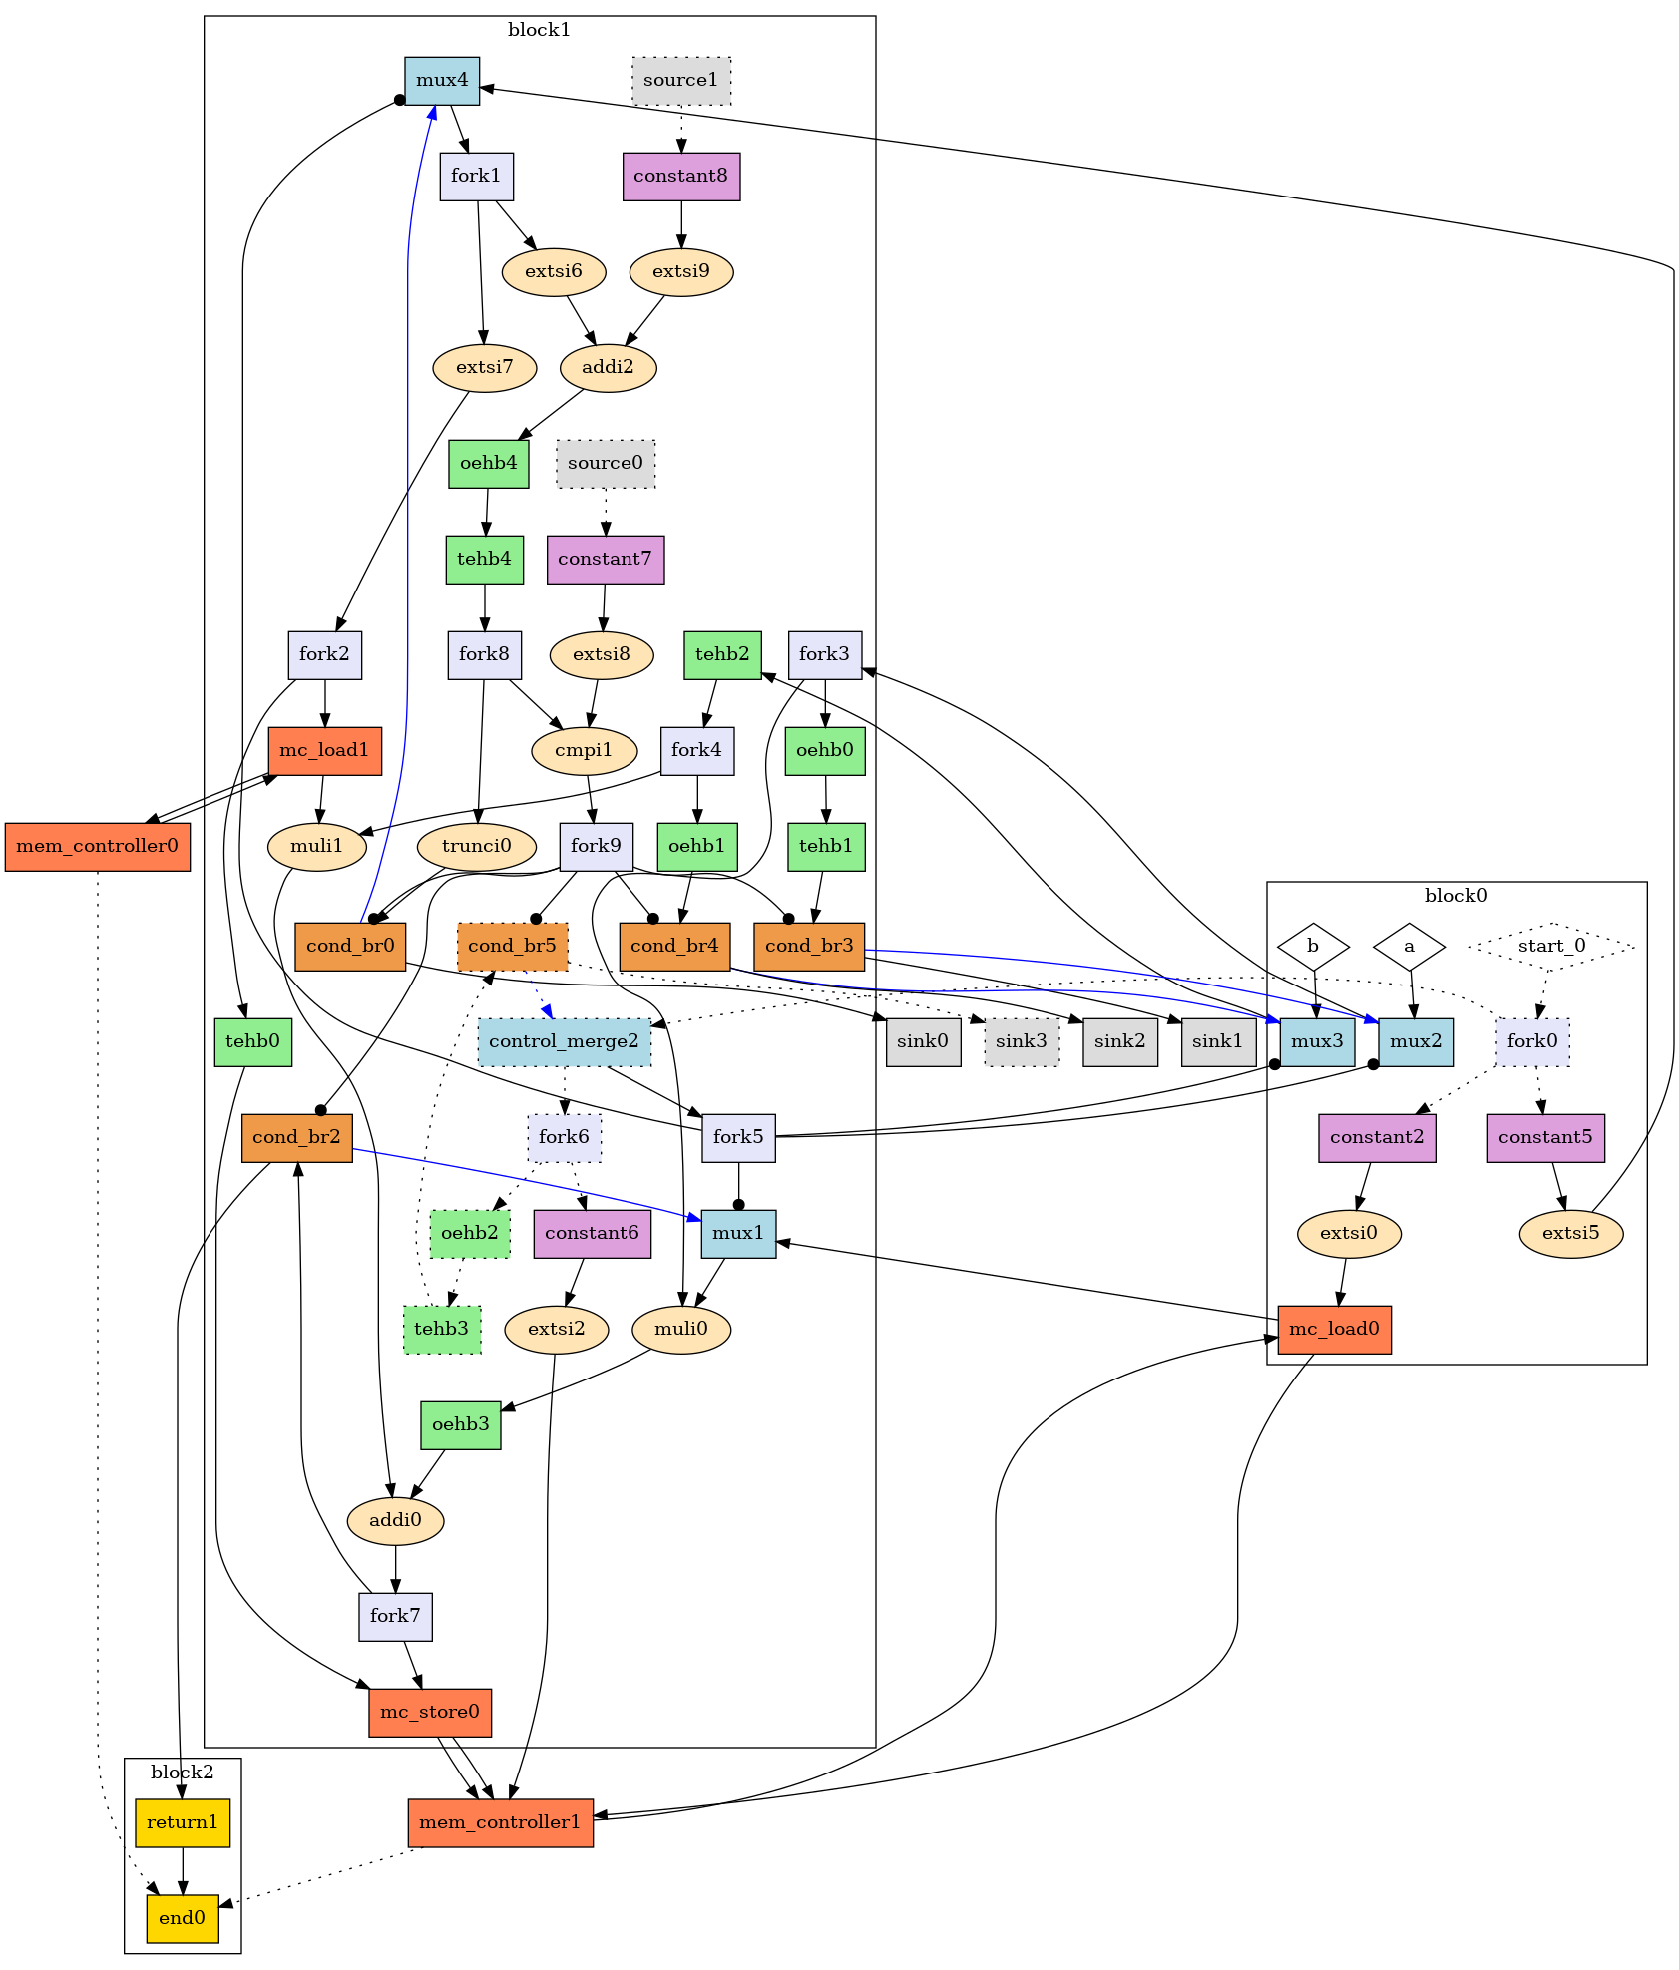
Back up
LUT #:
TEHB 642
OEHB 643
Pipeline 653
Notes:
把constraints放进一页

Slide 66
Back up
No ready path delay. Throughput unchanged
Benchmark | Utilization |  |  |  |  |  |  |  |  | Savings (%) Compared with
 | Dynamatic |  |  | Our work |  |  | FPGA '20 |  |  | Dynamatic |  | FPGA '20
 | LUT |  | Register | LUT |  | Register | LUT |  | Register | LUT | Reg. | LUT | Reg.
 | Total | Logic |  | Total | Logic |  | Total | Logic
fir | 466 | 470 | 531 | 415 | 413 | 483 | 461 | 457 | 535 | 10.0 | 9.7 | 10.94 | 9.04
iir | 666 | 666 | 869 | 622 | 611 | 764 | 715 | 715 | 946 | 13.0 | 19.2 | 6.61 | 12.08
if_loop_1 | 521 | 521 | 630 | 523 | 521 | 568 | 626 | 622 | 702 | 16.5 | 19.1 | -0.38 | 9.84
if_loop_2 | 543 | 543 | 596 | 524 | 524 | 529 | 594 | 594 | 631 | 11.8 | 16.2 | 3.50 | 11.24
sumi3_mem | 437 | 409 | 426 | 372 | 338 | 422 | 435 | 407 | 457 | 14.5 | 7.7 | 14.87 | 0.94
vedio_filter | 1547 | 1459 | 1187 | 1227 | 1148 | 1255 | 1569 | 1473 | 1325 | 21.8 | 5.3 | 20.69 | -5.73
matvec | 699 | 641 | 579 | 522 | 504 | 521 | 633 | 605 | 595 | 17.5 | 12.4 | 25.32 | 10.02
image_resize | 612 | 564 | 531 | 509 | 465 | 514 | 622 | 582 | 588 | 18.2 | 12.6 | 16.83 | 3.20
matrix | 841 | 777 | 587 | 628 | 614 | 541 | 722 | 710 | 607 | 13.0 | 10.9 | 25.33 | 7.84
Notes:
把constraints放进一页

Slide 67
Interesting Findings
In fir
Elastic Buffer
OEHB
OEHB
TEHB
TEHB
LUT #: 494
LUT #: 436

